Slide 1
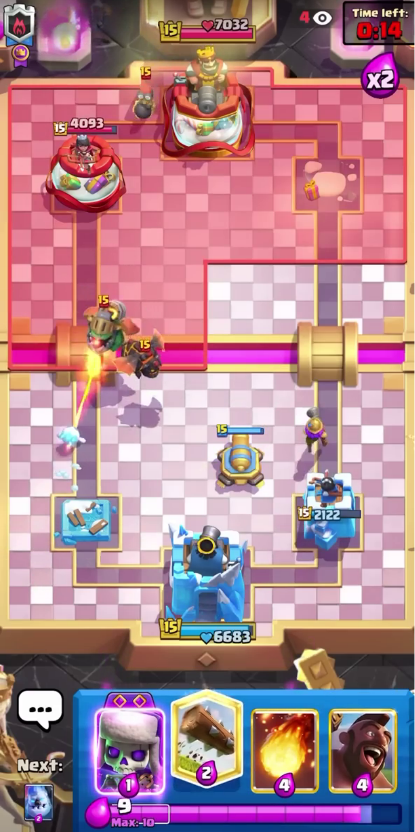
Game time
Enemy
ground troop
Enemy
king tower
Enemy
minor tower
Enemy
air troop
Our ground building
Our ground troop
Our ground troop
Our minor
tower
Our king
tower
Hand cards
Total elixir

